Slide 1


Goeasy
WE SERVE ,YOU DESERVE
Under guidance
Dr. Menakshi Nawal
H.O.D (Information technology)
NSP 2nd semester project

Slide 2

Our team
1.TILAK ATRI
2.HIMANSHU SINGH HADA
3.ISHANT KUSHWAH

Slide 3
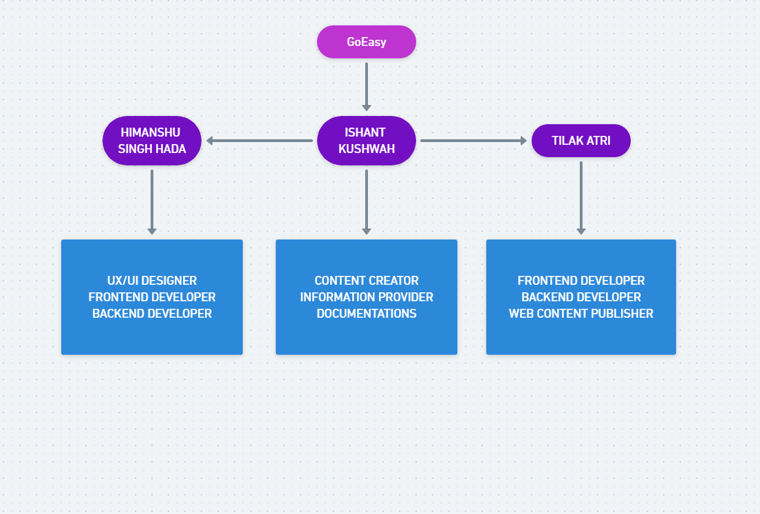
WORK PROFILE

Slide 4

OBJECTIVES
Save Time.
Quickly accessible.
Collection of all types of schemes.
Aware people.
Information about jobs.

Slide 5
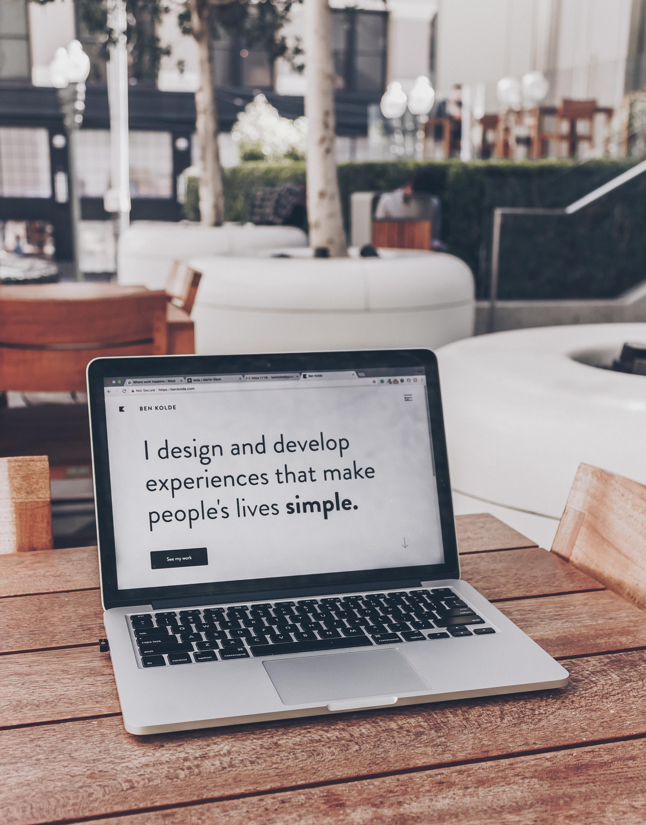
INTRODUCTION
This website is designed to provide information and registration links of important government schemes, government jobs, private jobs, donation links, NGOs.
This website helps people to find the right information and required registration links.

Slide 6
WHY ? THIS PROJECT
To provide service to them.
To enhance easy access to opportunities.
To contribute to society for development.
To provide possible source to help needy.
To enhance the quality of Web Serving with full efficiency.

Slide 7
FRONTEND
We used given below technologies on frontend work to design and arts to build frontend of our project.
Technologies used,
UX/UI Designing
Web designing
Vector Art
3D illustration

Slide 8
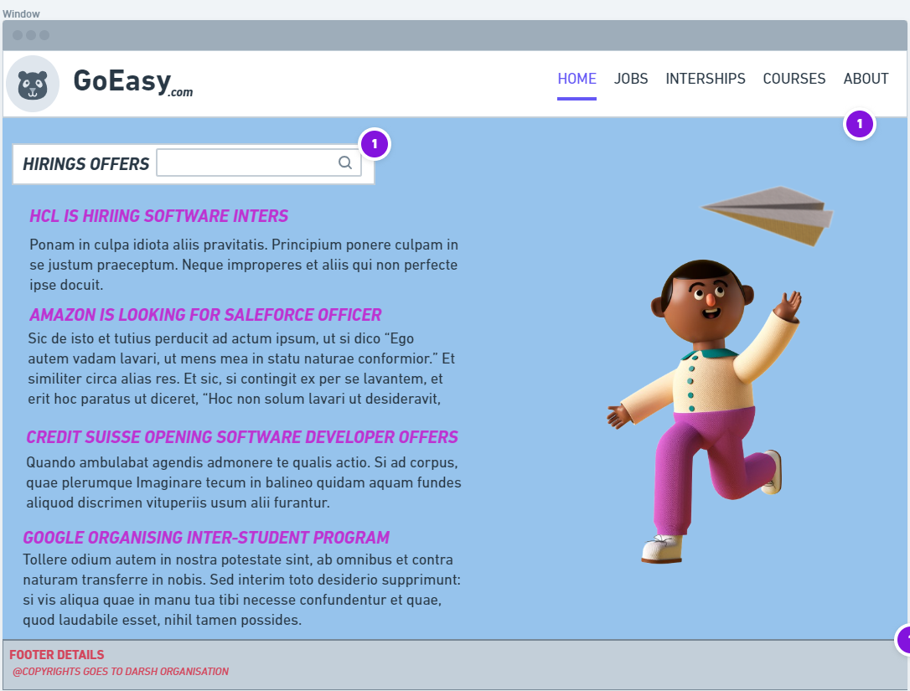
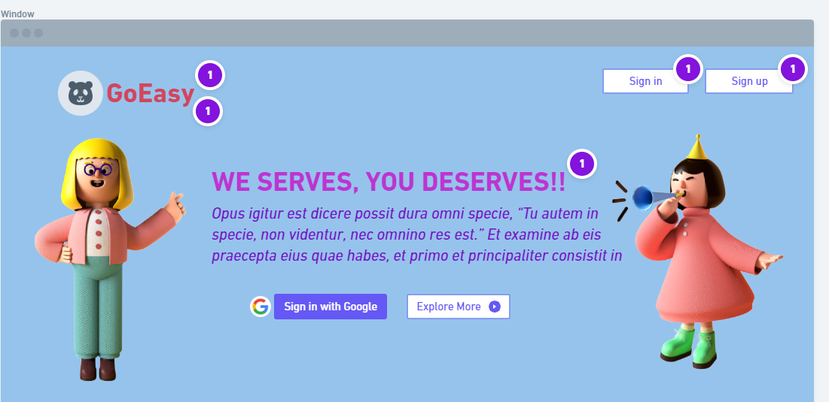
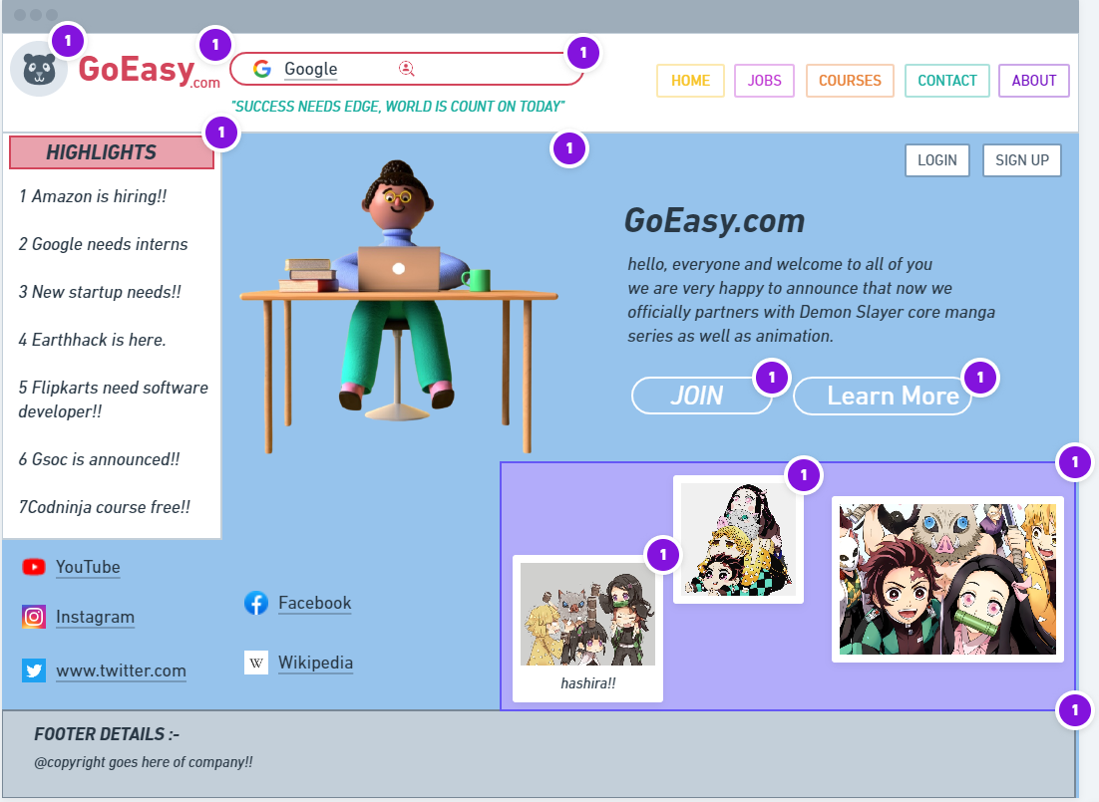
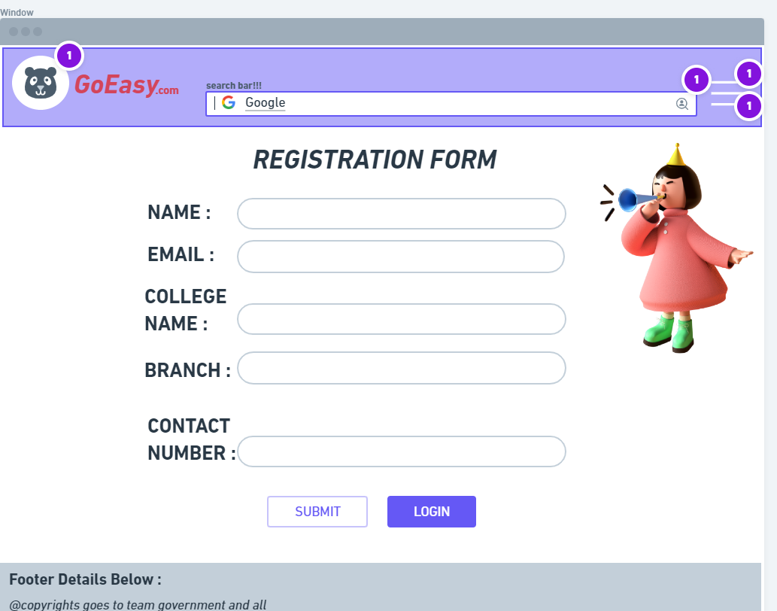
HOW IT LOOKS LIKE,

Slide 9
BACKEND
In Backend work we used given below programming as well as markup language to build Backend structure of our project.
Backend technologies:
JavaScript
Jquery
React
HTML5 & CSS3
API

Slide 10
Project completion
Work under progress
We are currently working on it. We are trying to build and design in more detailed and efficient way as well as including possible technologies, arts, illustration, design and various languages on it.

